Slide 1
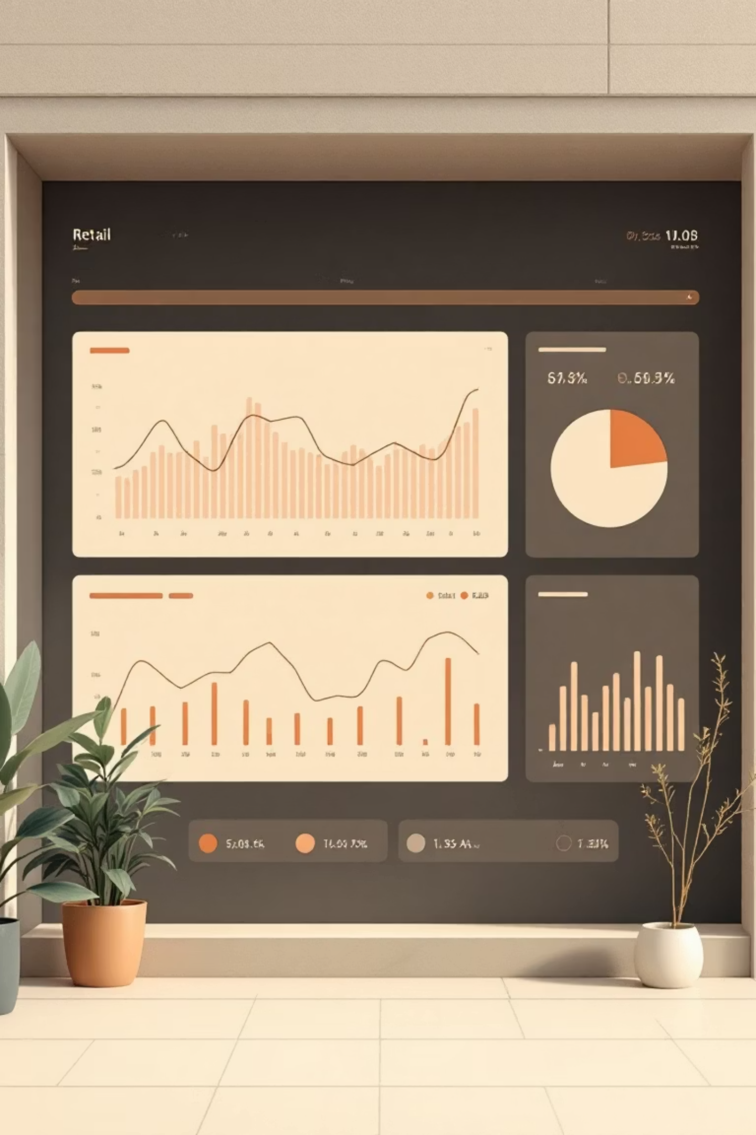
Customer Shopping Behavior Analysis
Uncovering insights from 3,900 purchases to guide strategic business decisions

Slide 2

DATASET OVERVIEW
The Foundation
3.9K
18
$59.76
Total Purchases
Data Points
Avg Purchase
Transactions analyzed across all categories
Features tracking demographics and behavior
Mean transaction value
3.75
Avg Rating
Customer satisfaction score

Slide 3

DATA PREPARATION
Python Analysis Pipeline
01
02
Data Loading & Exploration
Cleaning & Imputation
Imported dataset, checked structure with pandas
Handled 37 missing review ratings using median
03
04
Feature Engineering
Database Integration
Created age groups and purchase frequency metrics
Loaded cleaned data into PostgreSQL for SQL analysis

Slide 4

KEY INSIGHTS
SQL Business Intelligence
Revenue by Gender
Top-Rated Products
Male customers: $157,890
Gloves (3.86)
Female customers: $75,191
Sandals (3.84)
Boots (3.82)
Hat (3.80)
Shipping Preferences
Skirt (3.78)
Express: $60.48 avg
Standard: $58.46 avg

Slide 5


Customer Segmentation Reveals Loyalty
Loyal Customers
Returning
New
3,116 customers (80%)
701 customers (18%)
83 customers (2%)
Repeat purchasers driving revenue
Growth opportunity segment
Fresh acquisition potential
27%
43%
Subscription Rate
Discount Usage
1,053 subscribers vs 2,847 non-subscribers
1,677 purchases with discounts applied

Slide 6
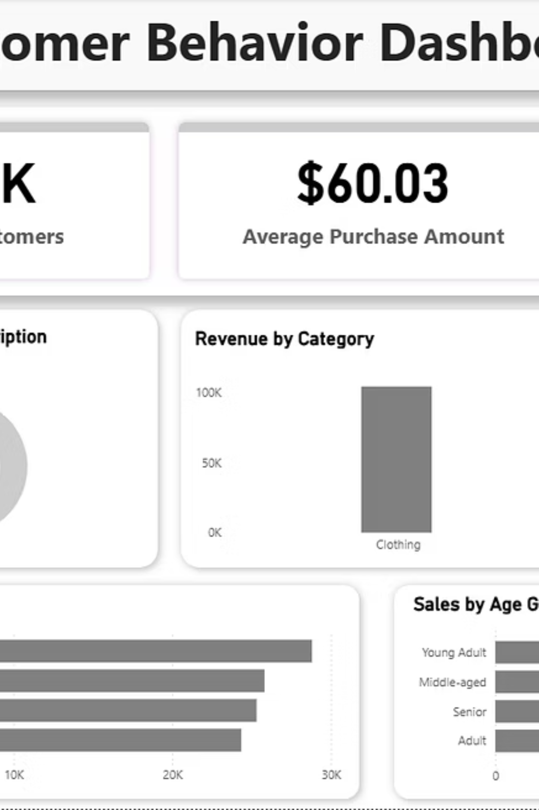
POWER BI DASHBOARD
Visual Intelligence
Revenue Leaders
Age Distribution
Interactive Filters
Young Adults generate highest revenue
Clothing dominates across all age groups
Slice by subscription, gender, category, shipping

Slide 7
ACTION PLAN
Strategic Recommendations
1
2
3
Boost Subscriptions
Loyalty Programs
Optimize Discounts
Promote exclusive benefits to convert 73% non-subscribers
Reward repeat buyers to strengthen 80% loyal segment
Balance sales boosts with margin control—839 high spenders use discounts
4
5
Product Positioning
Targeted Marketing
Highlight top-rated items (Gloves, Sandals, Boots) in campaigns
Focus on Young Adults and express-shipping users

